Slide 1
Matthew 26:36-46
36. Then Jesus went with his disciples to a place called Gethsemane, and he said to them, “Sit here while I go over there and pray.”
37. He took Peter and the two sons of Zebedee along with him, and he began to be sorrowful and troubled.
38. Then he said to them, “My soul is overwhelmed with sorrow to the point of death. Stay here and keep watch with me.”
39. Going a little farther, he fell with his face to the ground and prayed, “My Father, if it is possible, may this cup be taken from me. Yet not as I will, but as you will.”
40. Then he returned to his disciples and found them sleeping. “Couldn’t you men keep watch with me for one hour?” he asked Peter.
41 “Watch and pray so that you will not fall into temptation. The spirit is willing, but the flesh is weak.”

Slide 2
Matthew 26:36-46
42. He went away a second time and prayed, “My Father, if it is not possible for this cup to be taken away unless I drink it, may your will be done.”
43. When he came back, he again found them sleeping, because their eyes were heavy.
44. So he left them and went away once more and prayed the third time, saying the same thing.
45. Then he returned to the disciples and said to them, “Are you still sleeping and resting? Look, the hour has come, and the Son of Man is delivered into the hands of sinners.
46. Rise! Let us go! Here comes my betrayer!”

Slide 3
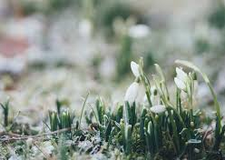
We Can Still Be Thankful

Slide 5
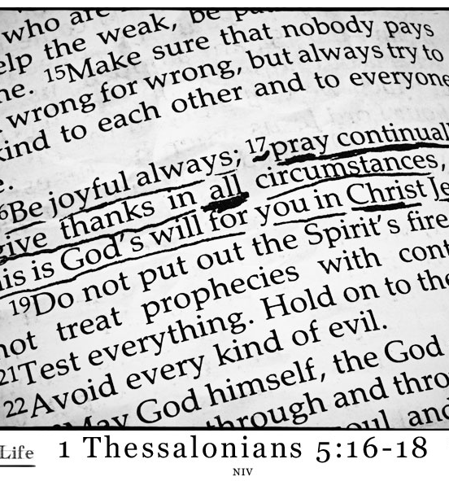
Rejoice always, pray without ceasing,
give thanks in all circumstances;
for this is the will of God in Christ Jesus for you.”
(1 Thessalonians 5:16-18)

Slide 6
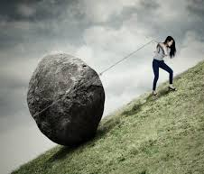
When we struggle, can we still be thankful?
Why?
How?

Slide 7
“In the beginning, God created the heavens and the earth.”
Genesis 1:1
“In the beginning was the Word, and the Word was with God, and the Word was God. He was with God in the beginning. Through him all the things were made; without him nothing was made that has been made.”
John 1:1-3

